Slide 1

Cyclistic Chicago
Bike Usage Patterns
Presented by:Omar Osman
Last Updated:29-01-2024

Slide 2
Table of Contents
Objective.
Data Sources.
Annual Members vs Casual Riders.
  User Types.
  Bike Types.
  Trips per Month.
  Trips per Season.
  Trips per Weekdays.
  Trips per Hours.
  Trips per Station.
  Conclusion.
Conclusion.
Appendix.
Recommendations.
Next Steps.

Slide 3
objective
Investigating how do annual members and casual riders use “Cyclistic” bikes differently?
Studying best time and location to put advertisment
By breaking the way members use cyclistic we can encourage Casual users to benefit from the app the way members benefits (eg: use it to go to university)
provide insights that will inform the design of a targeted marketing strategy to convert casual riders into annual members.

Slide 4
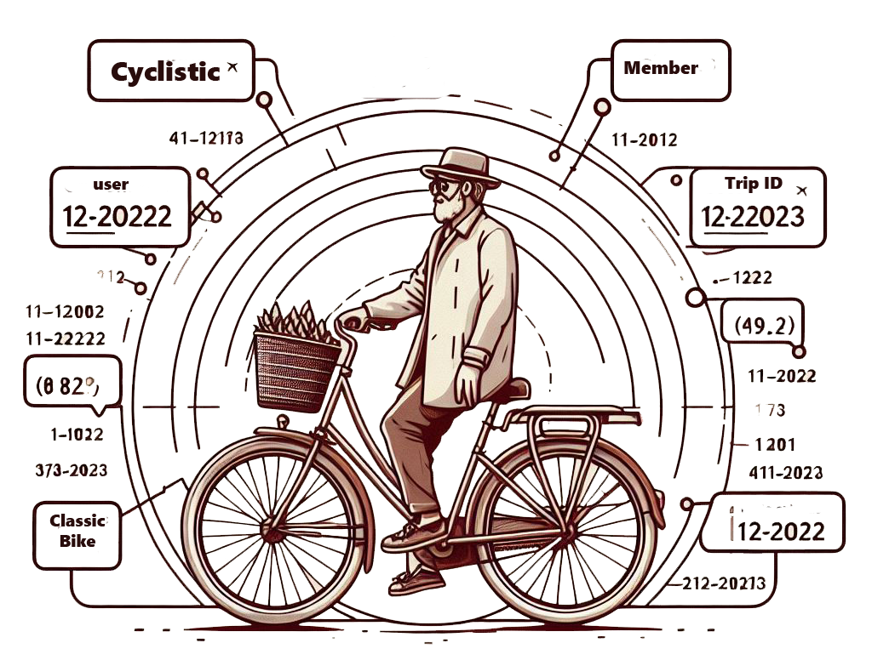
Data sources

Slide 5
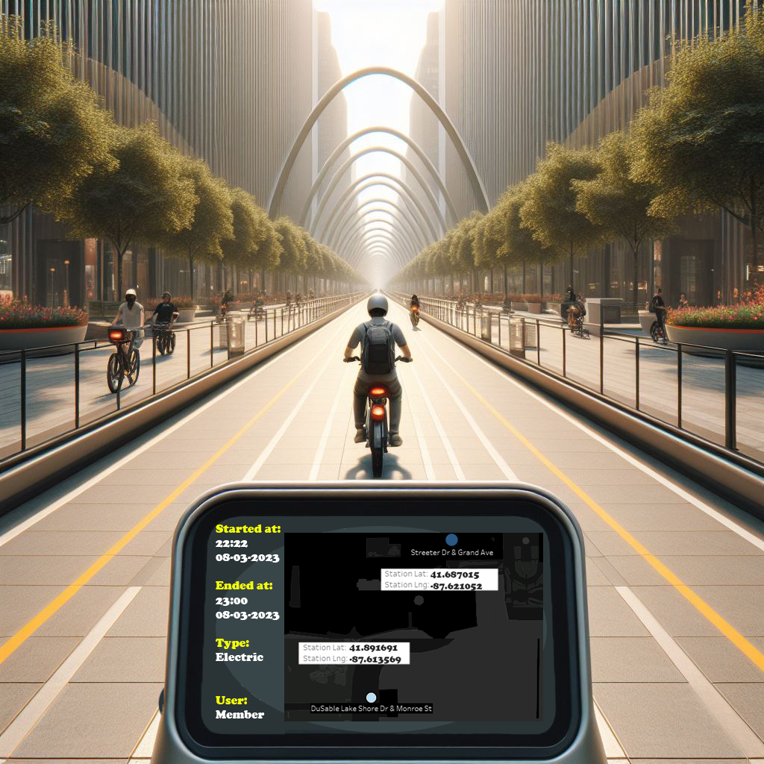
Data sources
We used Trips Data from
12-2022 to 11-2023.
  The data used contains information
  about Trips
    Trip Start and End Stations, and their coordinates
    Trip Start and End
    Type of User (Customer or Casual).
    Type of Bike (Classic or Electric).

Slide 6
annual members vs casual riders

Slide 7
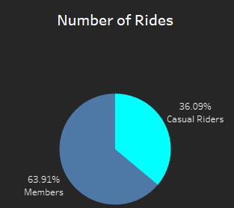
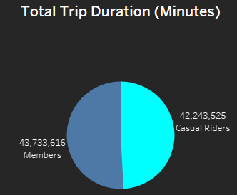
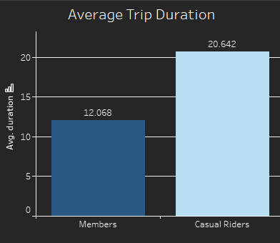
User Types
Members do more rides than Casual Riders.
While the total minutes ridden by both Members and Casual Riders are nearly equal.
The average trip duration for Casual Riders is nearly 70% longer than that of Members.

Slide 8
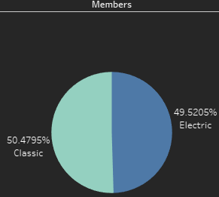
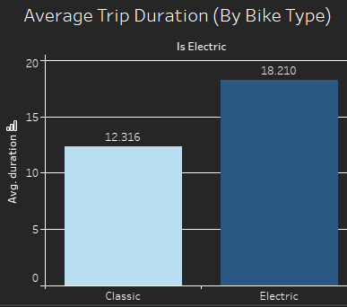
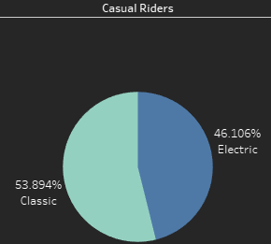
Bike Types
The average trip duration for Electric Bikes is nearly 50% longer than that of Classic Bike.
Members | Casual Riders
Members tend to use electric bikes and classic bikes with the same frequency nearly . | Casual riders tend to use classic bikes more than electric bikes.
But they use classic bike slightly more, absolute difference ≈1%. | Absolute difference ≈ 10.2%.

Slide 9
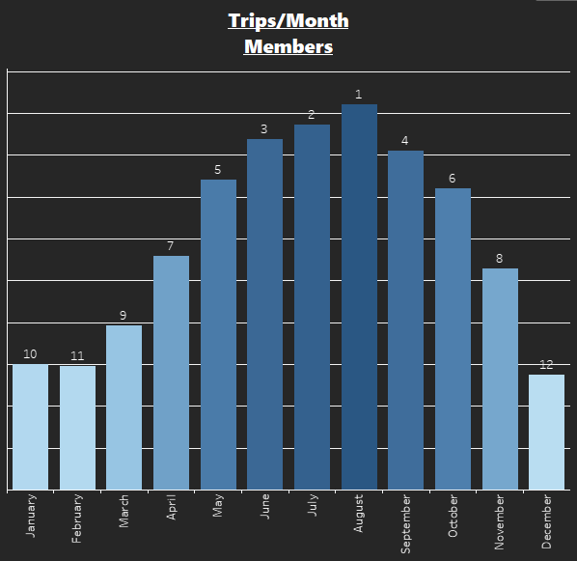
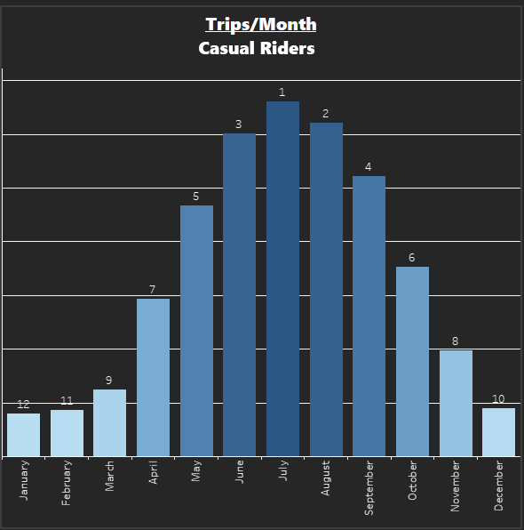
Trips Per Month
Members | Casual Riders
Month with most rides: August. | Month with most rides: July.
Month with Least rides: December. | Month with Least rides: January.

Slide 10
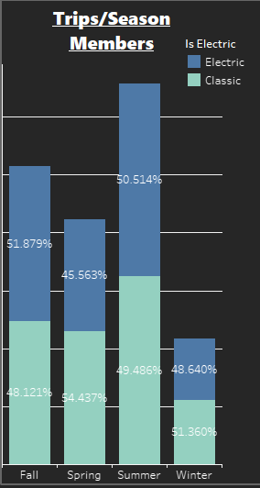
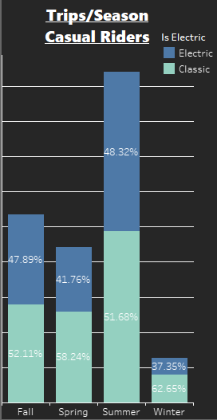
Trips Per Season
Members | Casual Riders
Season with most rides: Summer. | Season with most rides: Summer.
Season with Least rides: Winter. | Season with Least rides: Winter.
Members tend to: Use classic bikes in Winter and Spring Use Electric bikes in Summer and Fall | Casual Riders tend to use classic bikes no matter what is the season.

Slide 11
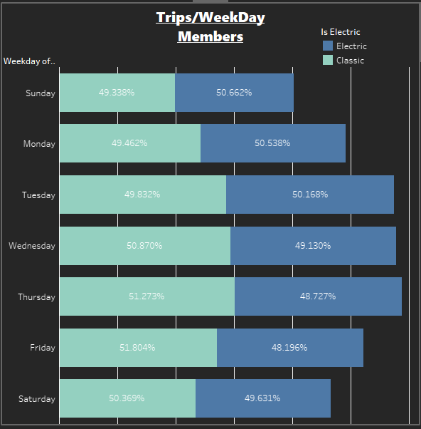
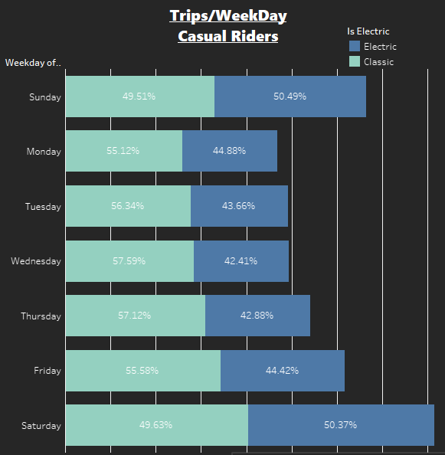
Trips Per Weekday
Members | Casual Riders
Weekday with most rides: Thursday. | Weekday with most rides: Saturday.
Weekday with Least rides: Sunday. | Weekday with Least rides: Monday.
There is no obvious trends of users riding frequency for bike types during weekdays | Casual Riders tend to use Electric bikes in the Weekends and Electric Bikes in the Weekdays .

Slide 12
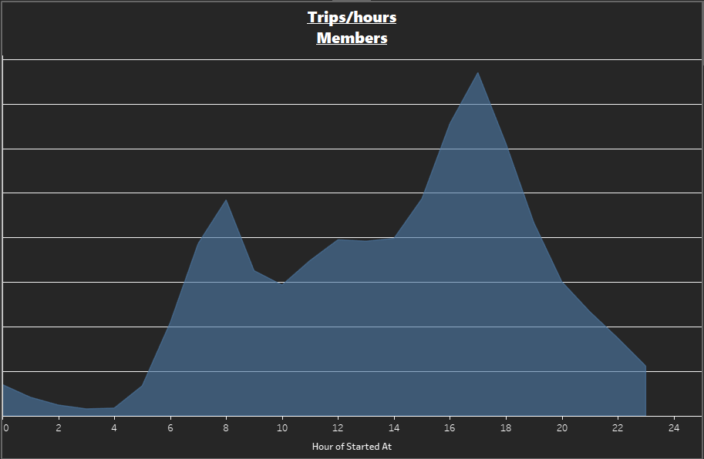
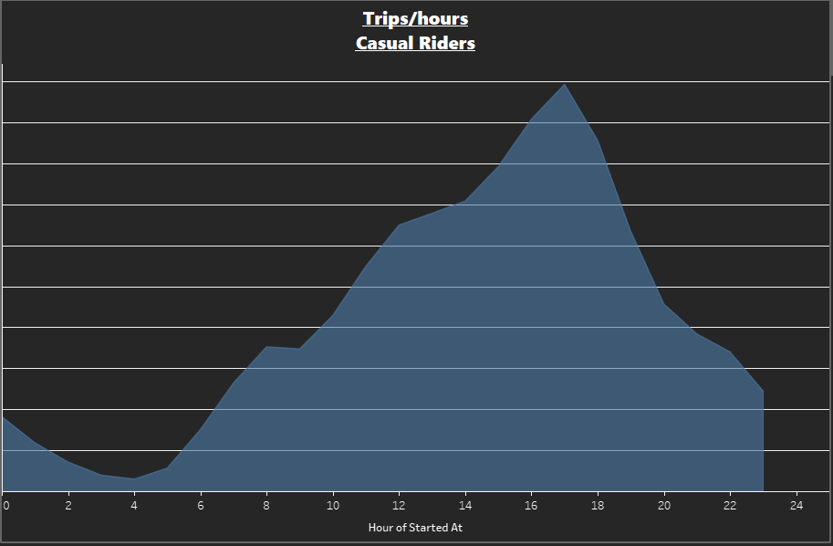
Trips Per Hours
Members | Casual Riders
Hour with most rides: 5:00 PM. | Hour with most rides: 5:00 PM.
Hour with Least rides: 3:00 AM. | Hour with Least rides: 4:00 AM.
Members have 2 peak hours, at 5:00 PM and 8:00 AM | Casual Riders have 1 peak hours, at 8:00 AM

Slide 13
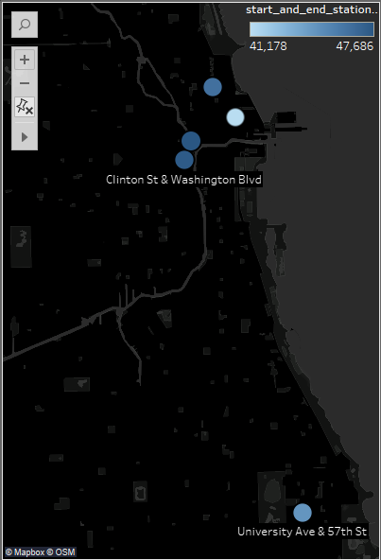
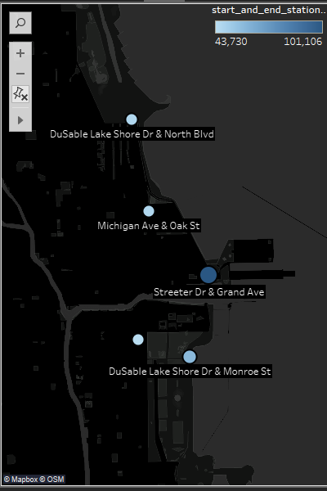
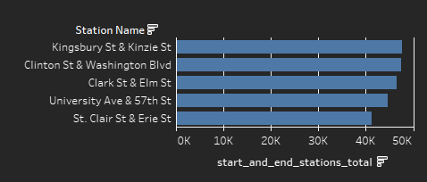
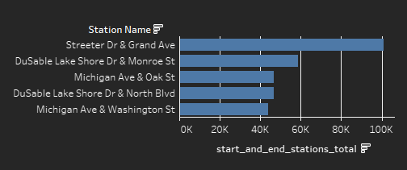
Trips Per Station
Members | Casual Riders
Station with most rides: Streeter Dr & Grand Ave. | Station with most rides: Kingsbury St & Kinzie St.
Members tend to use bikes more inside the town and to Universities. | Casuals tend to use bikes more inside on the coasts (Lake Michigan shore).

Slide 14
Conclusion
Members may be using bikes for commuting or errands; This is reflected on:
  Most used stations contains universities and workplaces.
  Shorter trips on average.
  peak riding times (8:00 AM and 5:00 PM) may be related to their work or school schedules.
  Less rides on weekends.

Slide 15
Conclusion (Contd.)
Casual Riders may be using bikes for leisure or recreation.; This is reflected on:
  Most used stations are on the shore of lake Michigan.
  Longer trips on average.
  peak riding time (5:00 PM) after work time.
  More rides on weekends.
  Huge difference between rides on summer and other seasons.

Slide 16
Conclusion (Contd.)
Overall,
members appear to use the bike share service more regularly and for a variety of purposes.
Whereas casual riders tend to use it more sporadically, mainly for leisurely rides, particularly on weekends and during summer months.
Additionally, members are more flexible in their bike choices, adapting them according to the season, whereas casual riders consistently prefer classic bikes.

Slide 17

Recommendations
Recommendations From the Analyst to the Marketing Team.
1.
Promo Codes.
2.
Tailored Membership Offers.
3.
Seasonal Promotions.
4.
Seasonal Promotions.
We can give students promo codes for annual memberships.
We can create a customized memberships for different prices.
Create seasonal marketing campaigns targeting casual riders during peak riding times and seasons, offering incentives such as free trial.
For Billboards, you can target areas that have the most used stations.

Slide 18
Next Steps
Further Analysis for Marketing Optimization
Longitudinal Analysis:
Examine trends over nine years to validate 2023 data.
Station Analysis:
Analyze station usage data, highlight popular locations.
Enhance Data Collection Strategy:
Collaborate for better collection methods and accuracy.
Notes:
Longitudinal Analysis:
Explore trends and patterns over the past nine years (Data already exists) to complement our findings from the 2023 data analysis. This comprehensive view will provide historical context and allow for confirmation of our conclusions, ensuring the robustness of our marketing strategies moving forward.
Station Analysis:
Collect and analyze data related to station usage, including popular locations.
Enhance Data Collection Strategy:
Engage stakeholders in discussions on enhancing the current data collection strategy. Identify potential improvements to address data errors, refine data collection methods, and incorporate additional contextual information to enrich future analyses

Slide 19
appendices
Cyclistic's Data Exploring.
Cyclistic's Data Cleaning.
Tableau Dashboard.
Cyclistic's Data Exploring.
Cyclistic's Data Cleaning.
Cyclistic MainDashboard

Slide 20
THANK YOU
Omar Osman
+2012-8971-5812
OmrMhmd007@gmail.com
Linktr.ee/omrosman

